Slide 1


Advanced Programming (Java) Qurratulain Malik qmalik@keyin.com

Slide 2
Introduction to Object-Oriented Programming using java
Outline
1.1 Machine Languages, Assembly Languages and High- Level Languages 1.2 History of Java 1.3 Java Class Libraries and basics of a Typical Java Environment
1.4 IDE’s for Java
1.5 First Program in Java: Printing a Line of Text Compiling and Executing your First Java Application 1.6 Modifying Our First Java Program Displaying a Single Line of Text with Multiple Statements Displaying Multiple Lines of Text with a Single Statement 1.7 Memory Concepts 1.8 Arithmetic 1.9 Decision Making: Equality and Relational Operators

Slide 3
Course Outline
TEXT BOOK
Java 8 Fundamentals: Modern Java Development with Lambdas, Streams, and Introducing Java 9’s JShell and the Java Platform Module System (JPMS)
RECOMMENDED BOOKS
“Java How to Program”, by Deitel & Deitel, 9th Edition
“Java 2: The Complete Reference”, by Patrick Naughton and Herbert Schildt
“Thinking in Java” by Bruce Eckel, Prentice Hall, 4th Edition, 2006
“Beginning Java 2” by Ivor Horton

Slide 4
1.1 Machine Languages, Assembly Languages and High-Level Languages
Machine language
“Natural language” of computer component
Machine dependent
Assembly language
English-like abbreviations represent computer operations
Translator programs convert to machine language
High-level language
Allows for writing more “English-like” instructions
Contains commonly used mathematical operations
Compiler convert to machine language
Interpreter
Execute high-level language programs without compilation

Slide 5
1.2 History of Java
Java
Originally for intelligent consumer-electronic devices
Then used for creating Web pages with dynamic content
Now also used for:
Develop large-scale enterprise applications
Enhance WWW server functionality
Provide applications for consumer devices (cell phones, etc.)
Java is Structured programming
Structured Programming
Structured programming is a programming paradigm aimed at improving the clarity, quality, and development time of a computer program by making extensive use of the structured control flow constructs of selection and repetition, block structures, and subroutines.
Clearer than unstructured programs
Easier to test, debug and modify

Slide 6
1.3 Basics of a Typical Java Environment and Java Class Libraries
Java systems contain
Environment
Language
APIs
Class libraries
Classes
Contain methods that perform tasks
Return information after task completion
Used to build Java programs
Java contains class libraries
Known as Java APIs (Application Programming Interfaces)

Slide 7
1.3 Basics of a Typical Java Environment (cont.)
Java programs normally undergo five phases
Edit
Programmer writes program (and stores program on disk)
Compile
Compiler creates bytecodes from program
Load
Class loader stores bytecodes in memory
Verify
Verifier ensures bytecodes do not violate security requirements
Execute
Interpreter translates bytecodes into machine language

Slide 8
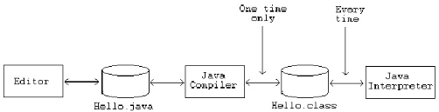
Phases of Java Program
The following figure describes the process of compiling and executing a java program.

Slide 9
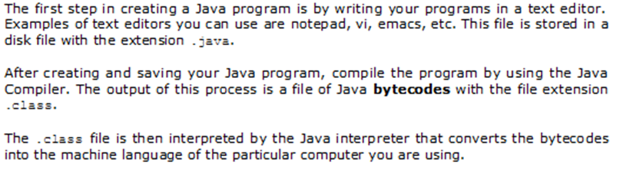
Phases of Java Program (Contd)
Task | Tool to Use | Output
Write the program | Any text Editor | File with .java extension
Compile the program | Java Compiler javac Myprogram.java | File with .class extension (Java bytecodes)
Run the program | Java Interpretor java MyProgram | Program output

Slide 10
Version | Release date
JDK Beta | 1995
JDK 1.0 | January 1996
JDK 1.1 | February 1997
J2SE 1.2 | December 1998
J2SE 1.3 | May 2000
J2SE 1.4 | February 2002
J2SE 5.0 | September 2004
Java SE 6 | December 2006
Java SE 7 | July 2011
Java SE 8 (LTS) | March 2014
Java SE 9 | September 2017
Java SE 10 | March 2018
Java SE 11 (LTS) | September 2018
Java SE 12 | March 2019
Java SE 13 | September 2019
Java SE 14 | March 2020
Java SE 15 | September 2020
Java SE 16 | March 2021
Java SE 17 (LTS) | September 2021
Java SE 18 | March 2022
Goals: Java Language
It should be "simple, object-oriented and familiar".
It should be "robust and secure".
It should be "architecture-neutral and portable".
It should execute with "high performance".
It should be "interpreted, threaded, and dynamic".
Major release versions of Java, along with their release dates:
Versions
https://en.wikipedia.org/wiki/Java_version_history

Slide 11
Benefits of Java to Programming Community
Support GUIs and multimedia capabilities such as graphics, images, animation, audio and video.
Run on internet and communicate with other applications
Applications can take advantage of the flexibility and performance improvements of multithreading
Applications with richer file processing than is provided by C or C++.
Not limited to the desktop or even to some local computer network but can integrate Internet components and remote databases as well.
Applications that can be written quickly and correctly in a manner that takes advantage of prebuilt software components.
Easy access to a growing universe of reusable software components.
Programmers want all these benefits in a truly portable manner, so that applications will run without modification on a variety of platforms

Slide 12
Motivation
The original motivation for java
The need for platform independent language that could be embedded with various consumer electronic products like toasters and refrigerators
One of the first project developed using java
A personal handheld remote control names start 7.
At the same time world wide web and internet was gaining popularity. Gosling et. Al. realized that Java could be used for Internet programming.

Slide 13
1.4 Integrated Development Environments
Note that taste in IDEs is a highly personal matter, but following are the most popular choices
Eclipse
IntelliJ IDEA
NetBeans
JDeveloper
BlueJ
VS Code
Leveraging the power of Visual Studio Code, Java developers get an excellent tool for both quick code editing and also the full debugging and testing cycle. It's a great choice for your Java work if you're looking for a tool which helps start your Java journey without installing and learning a complex IDE.
https://code.visualstudio.com/docs/java/java-tutorial

Slide 14
JAVA
James Gosling, Mike Sheridan, and Patrick Naughton initiated the Java language project in June 1991.
Java was originally designed for interactive television, but it was too advanced for the digital cable television industry at the time.
The language was initially called Oak after an oak tree that stood outside Gosling's office; it went by the name Green later, and was later renamed Java, from Java coffee, said to be consumed in large quantities by the language's creators.
Sun Microsystems released the first public implementation as Java 1.0 in 1995. It promised "Write Once, Run Anywhere" (WORA), providing no-cost run-times on popular platforms.
With the advent of Java 2 , new versions had multiple configurations built for different types of platforms. For example, J2EE targeted enterprise applications and the greatly stripped-down version J2ME for mobile applications (Mobile Java). J2SE designated the Standard Edition.
In 2006, for marketing purposes, Sun renamed new J2 versions as Java EE, Java ME, and Java SE, respectively.
In 2007, Sun made the Java's core code available under free software/open-source distribution terms.

Slide 15
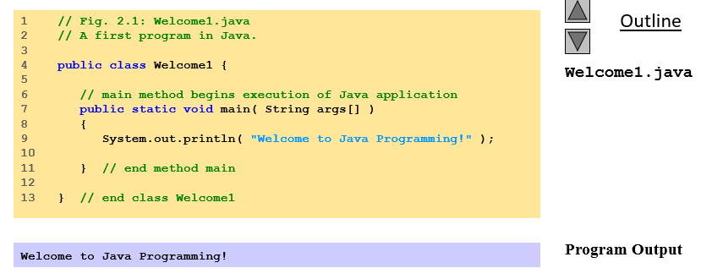
1.5 A Simple Program: Printing a Line of Text
Application
Program that executes using the java interpreter
Sample program
Show program, then analyze each line

Slide 16
public static void main(String args[])
The Main method is the method in which execution to any java program begins. A main method declaration looks as follows: public static void main(String args[]){ }
The method is public because it be accessible to the JVM to begin execution of the program.
It is Static because it be available for execution without an object instance. you may know that you need an object instance to invoke any method. So you cannot begin execution of a class without its object if the main method was not static.
It returns only a void because, once the main method execution is over, the program terminates. So there can be no data that can be returned by the Main method
The last parameter is String args[]. This is used to signify that the user may opt to enter parameters to the java program at command line. We can use both String[] args or String args[]. The Java compiler would accept both forms.

Slide 17
A Simple Program: Printing a Line of Text
1 // Fig. 2.1: Welcome1.java
Comments start with: //
Comments ignored during program execution
Document and describe code
Provides code readability
Multiple line comments: /* ... */
/* This is a multiple
line comment. It can
be split over many lines */
Another line of comments
Note: line numbers not part of program, added for reference
2 // A first program in Java.

Slide 18
A Simple Program: Printing a Line of Text
3
Blank line
Makes program more readable
Blank lines, spaces, and tabs are white-space characters
Ignored by compiler
Begins class definition for class Welcome1
Every Java program has at least one user-defined class
Keyword: words reserved for use by Java
class keyword followed by class name
Naming classes: capitalize every word
SampleClassName
4 public class Welcome1 {

Slide 19
A Simple Program: Printing a Line of Text
4 public class Welcome1 {
Name of class called identifier
Series of characters consisting of letters, digits, underscores ( _ ) and dollar signs ( $ )
Does not begin with a digit, has no spaces
Examples: Welcome1, $value, _value, button7
7button is invalid
Java is case sensitive (capitalization matters)
a1 and A1 are different
For chapters 2 to 7, use public keyword
Certain details not important now
Mimic certain features, discussions later

Slide 20
A Simple Program: Printing a Line of Text
4 public class Welcome1 {
Saving files
File name must be class name with .java extension
Welcome1.java
Left brace {
Begins body of every class
Right brace ends definition (line 13)
Part of every Java application
Applications begin executing at main
Parenthesis indicate main is a method (ch. 6)
Java applications contain one or more methods
7 public static void main( String args[] )

Slide 21
A Simple Program: Printing a Line of Text
Exactly one method must be called main
Methods can perform tasks and return information
void means main returns no information
For now, mimic main's first line
Left brace begins body of method definition
Ended by right brace } (line 11)
7 public static void main( String args[] )
8 {

Slide 22
A Simple Program: Printing a Line of Text
9 System.out.println( "Welcome to Java Programming!" );
Instructs computer to perform an action
Prints string of characters
String - series characters inside double quotes
White-spaces in strings are not ignored by compiler
System.out
Standard output object
Print to command window (i.e., MS-DOS prompt)
Method System.out.println
Displays line of text
Argument inside parenthesis
This line known as a statement
Statements must end with semicolon ;

Slide 23
A Simple Program: Printing a Line of Text
11 } // end method main
Ends method definition
Ends class definition
Can add comments to keep track of ending braces
Lines 8 and 9 could be rewritten as:
Remember, compiler ignores comments
Comments can start on same line after code
13 } // end class Welcome1

Slide 24
Compiling and Executing your First Java Application
Compiling a program and run your program.

Slide 25
1.6 Modifying Our First Java Program
Modify example in Fig. 2.1 to print same contents using different code

Slide 26
Displaying a Single Text with Multiple Statements
Modifying programs
The following code produces same output as Welcome1.java (Fig. 2.1)
Using different code
Line 9 displays “Welcome to ” with cursor remaining on printed line
Line 10 displays “Java Programming! ” on same line with cursor on next line
9 System.out.println( "Welcome to " );
10 System.out.println( "Java Programming!" );

Slide 27
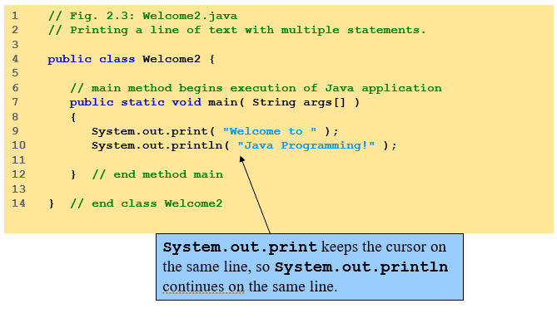
Displaying a Single Text with Multiple Statements

Slide 28
Displaying Multiple Lines of Text with a Single Statement
Newline characters (\n)
Interpreted as “special characters” by methods System.out.print and System.out.println
Indicates cursor should be on next line
Line breaks at \n
Usage
Can use in System.out.println or System.out.print to create new lines
System.out.println( "Welcome\nto\nJava\nProgramming!" );
9 System.out.println( "Welcome\nto\nJava\nProgramming!" );

Slide 29
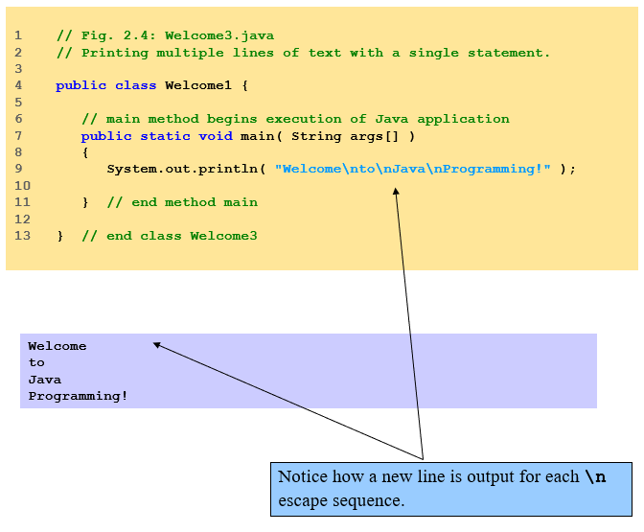
Displaying Multiple Lines of Text with a Single Statement

Slide 30
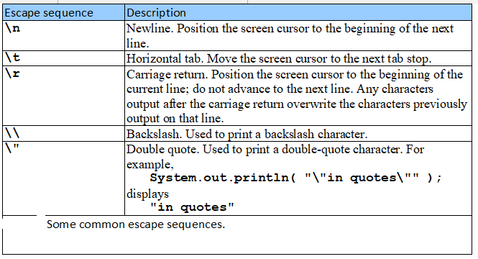
Displaying Multiple Lines of Text with a Single Statement
Escape characters
Backslash ( \ )
Indicates special characters be output

Slide 31
1.7 Memory Concepts
Visual Representation
Sum = 0; number1 = 1; number2 = 2;
Sum = number1 + number2; after execution of statement
sum
0
sum
3

Slide 32
1.8 Arithmetic
Arithmetic calculations used in most programs
Usage
* for multiplication
/ for division
+, -
No operator for exponentiation (more in Chapter 5)
Integer division truncates remainder
7 / 5 evaluates to 1
Modulus operator % returns the remainder
7 % 5 evaluates to 2
Operator precedence
Some arithmetic operators act before others (i.e., multiplication before addition)
Use parenthesis when needed
Example: Find the average of three variables a, b and c
Do not use: a + b + c / 3
Use: (a + b + c ) / 3
Follows PEMDAS
Parentheses, Exponents, Multiplication, Division, Addition, Subtraction

Slide 33
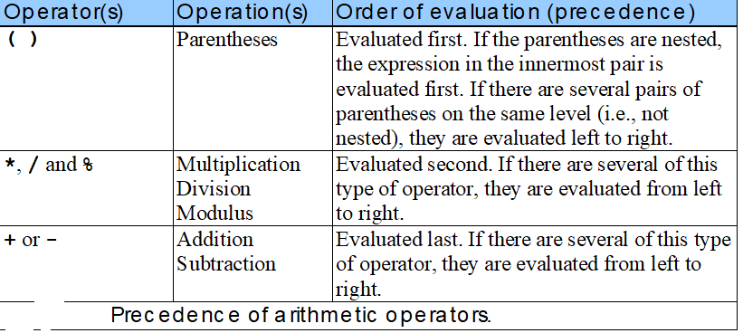
1.8 Arithmetic

Slide 34
1.9 Decision Making: Equality and Relational Operators
if control structure
Simple version in this section, more detail later
If a condition is true, then the body of the if statement executed
0 interpreted as false, non-zero is true
Control always resumes after the if structure
Conditions for if structures can be formed using equality or relational operators (next slide)
if ( condition )
statement executed if condition true
No semicolon needed after condition
Else conditional task not performed

Slide 35
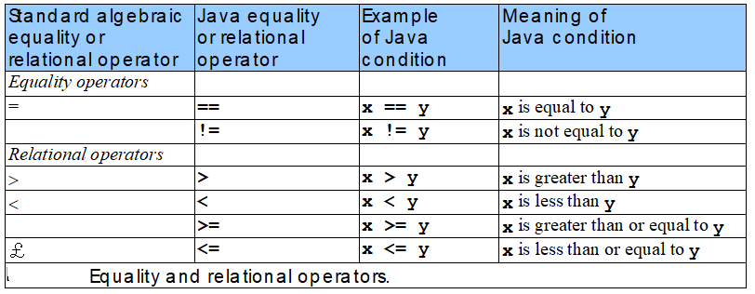
1.12 Decision Making: Equality and Relational Operators

Slide 36
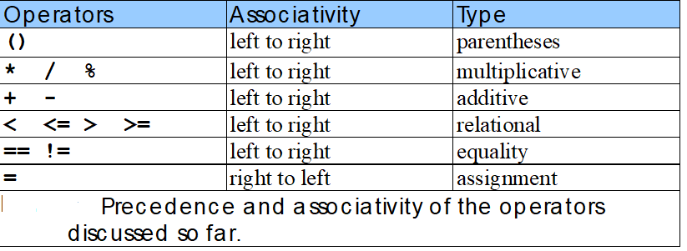
1.9 Decision Making: Equality and Relational Operators
Precedence of operators
All operators except for = (assignment) associates from left to right
For example: x = y = z is evaluated x = (y = z)

Slide 37
Some useful links
Text Book videos
https://learning.oreilly.com/videos/java-8-fundamentals/9780133489354/
Java Coding Help
https://www.w3schools.com/java/java_intro.asp
https://beginnersbook.com/2013/05/java-introduction/
Java Examples from book chapters
Other Books | Deitel & Associates, Inc.
Pearson - Online Resources for Deitel (pearsoncmg.com)

